Slide 1
Sprint 4 Demo
Tuesday, June 14th, 2022

Slide 2
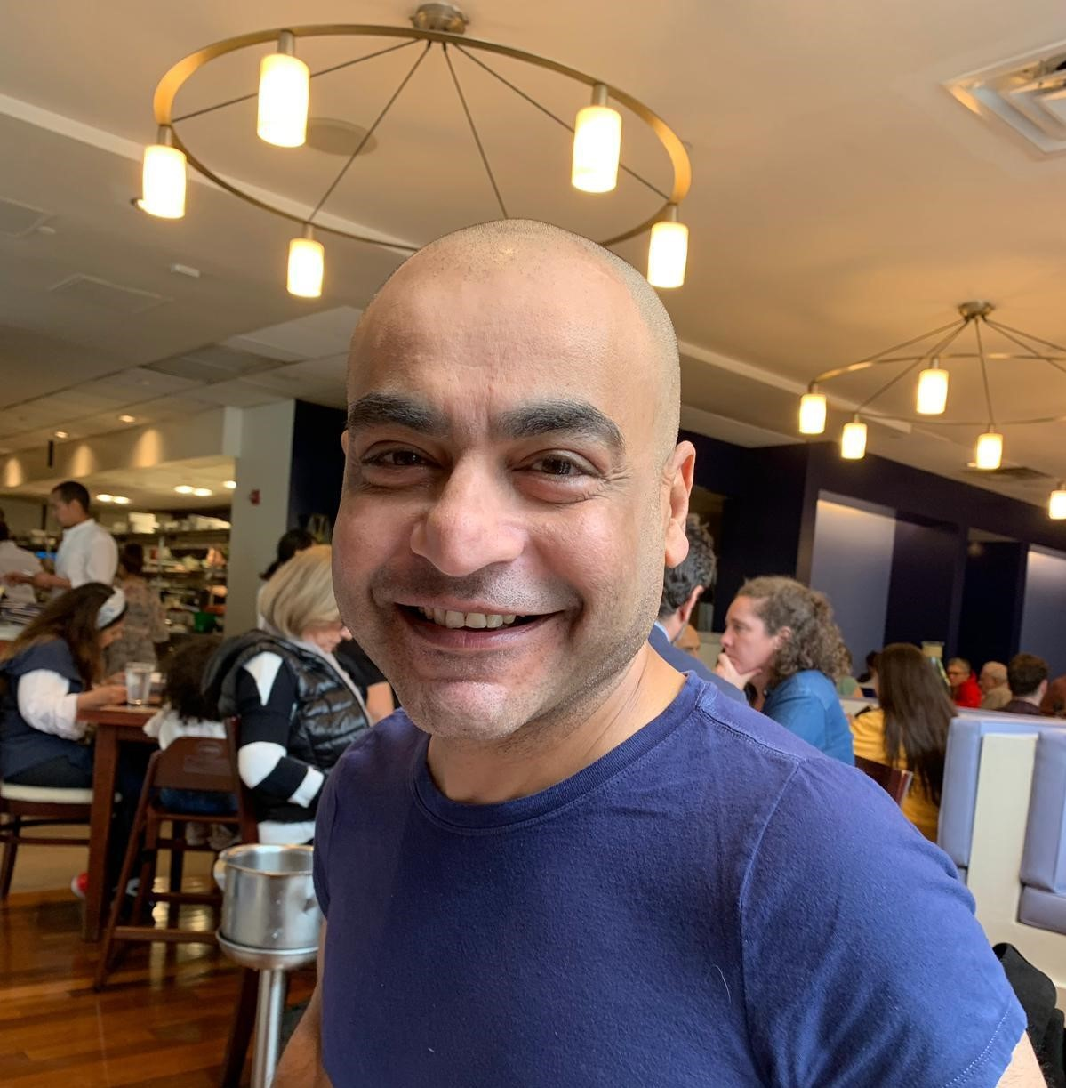
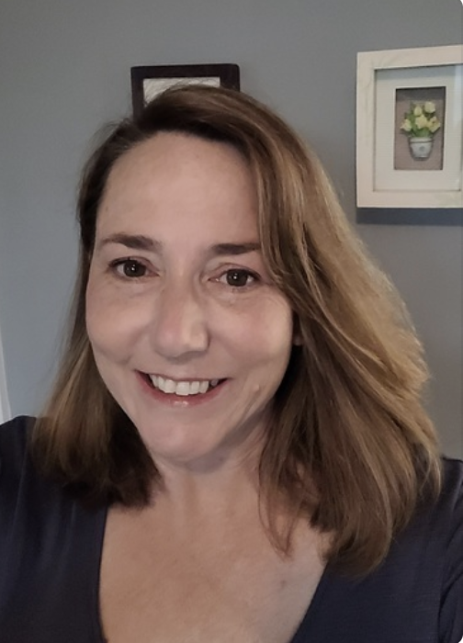
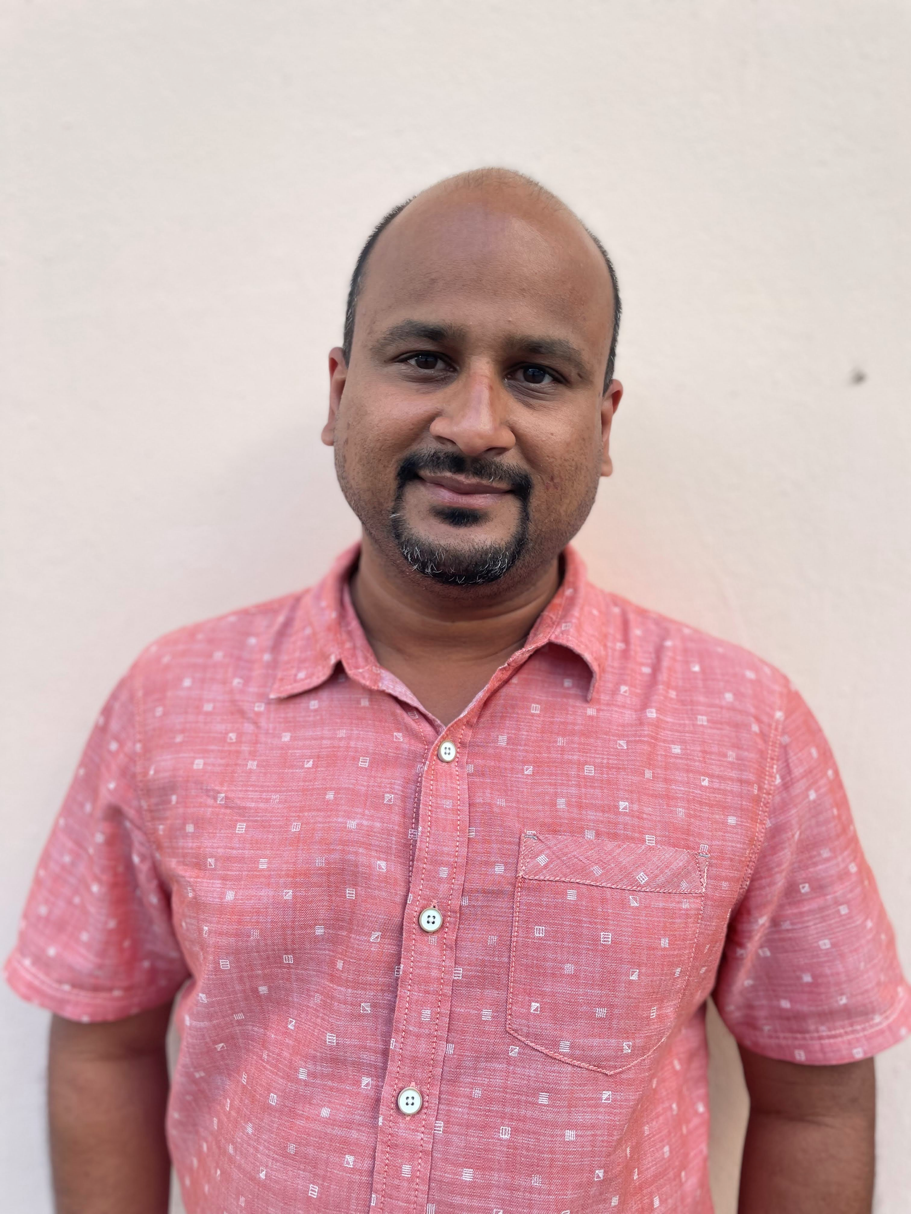








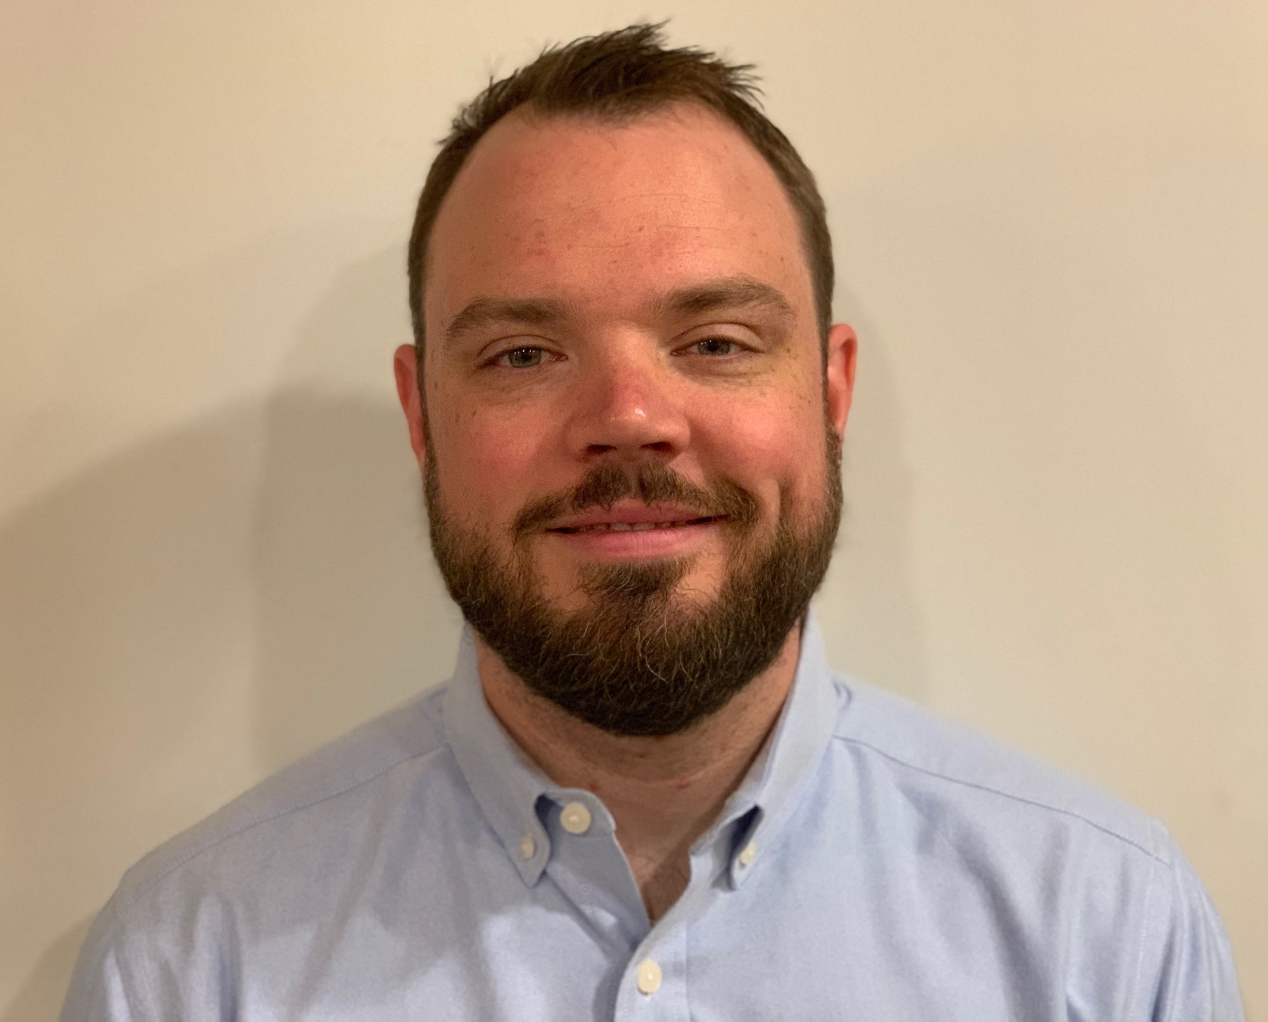
Get to know the team
Core team
Executive team
PRODUCT
ENGINEERING
Munish Sikka
Washington DC
Product Lead
Tami Corson
North Carolina
Clinical SME / Scrum
Shashank Khandelwal
Rockville, MD
Tech Lead
Jeff Scheire
MO Studio
Marcy Jacobs
McKinsey & Co
Kevin London Frog Design
DESIGN
Thomas McCue Oak Park, IL Principal Designer Director
Carl Dickerson Atlanta, GA Content Strategist and Plain Language Content Creator
Carolyn Williams Chicago, IL Experience Designer
Will Reynolds SERVE Advisory
Ben Morris
Pluribus Digital
Travis Hoffmann
MO Studio
06-14 Sprint 4 Demo
Introduction

Slide 3



At the end of each sprint on Tuesdays, the team will run sprint reviews to showcase the sprint’s work for approval. The purpose of this meeting is:
WELCOME TO THE SPRINT 4 DEMO
1
To demo the accomplishments or functionality that was built over the past sprint
2
To get feedback and insights early and often
3
To create transparency for anyone interested on the product and progress
06-14 Sprint 4 Demo
Introduction

Slide 4
CEDAR TO1 Overview
WE ARE HERE
PHASE
CY 2021
CY 2022
SPRINT
0
1
2
3
4
5
6
7
8
9
10
11
12
13
14
15
16
17
18
19
20
21
22
23
24
25
26
27
MONTH
Sep
Oct
Nov
Dec
Jan
Feb
Mar
Apr
May
Jun
Jul
Aug
Sep
DHM - Health Apartment
FOCUS
1095-B Form
Follow ups as needed
Community Care
Health Hub
06-14 Sprint 4 Demo
Introduction

Slide 5
Agenda
Sprint Goal:
For sprint 4 we focused on launching our first round of IA testing, creation of prototypes, draft protocol for future testing, and began work on 1095-B opt-in to digital retrieval feature.
HEALTH HUB
IA tree test status
Wireframe prototypes
Research goal and questions for next phase
1095-B
Designed post-MVP opt-in element
1095-B MVP blocker updates
 | We welcome all feedback! Feedback will be collectively reviewed and prioritized appropriately based on where it stacks against other stories in the backlog as well as technical feasibility.
06-14 Sprint 4 Demo
Agenda

Slide 6
Health Hub
SPRINT 4 DEMO
06-14 Sprint 4 Demo

Slide 7



Health Hub Workplan v4
Owned by design team
Owned by product team
WE ARE HERE
SPRINT 1
4/20 – 5/03
SPRINT 2
5/04 – 5/17
SPRINT 3
5/18 – 5/31
SPRINT 4
6/01 – 6 /14
SPRINT 5
6/15 – 6/28
SPRINT 6
6/29 – 7/12
SPRINT 7
7/13 – 7/26
SPRINT 8
7/27 – 8/09
SPRINT 9
8/10 – 8/23
SPRINT 10
8/24 – 9/6
Kickoff
Build understanding of product and product goals
Build Roadmap
Product & Delivery
Build initial workplan and backlog
Business partner discovery
Prototyping
Prototype Research
User Experience & Design
Comparative research
Consolidate existing research
Experience Map
Potential Second Prototype Research
Current state mapping
Research Activities Plan (RAP)
Final Recommended Prototype
IA Tree Test Plan H0 & H1
Final IA Recommendations delivered
Engineering & Development
Tech Discovery
Tech Feasibility
06-14 Sprint 4 Demo
Workplan

Slide 8
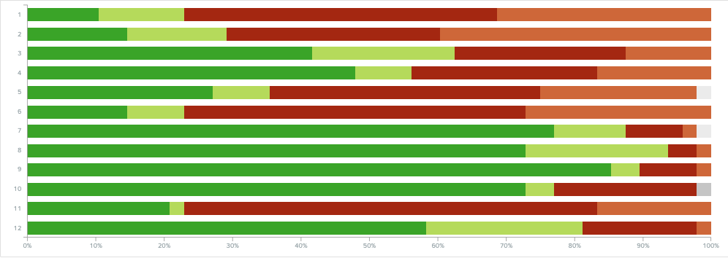
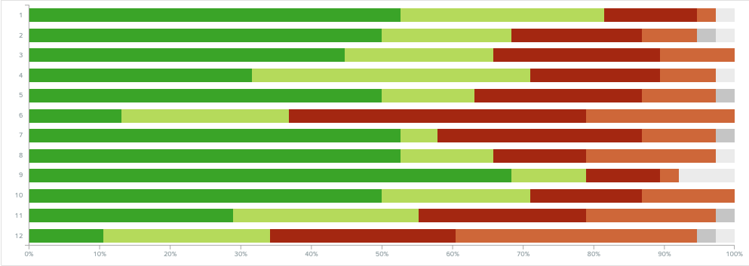
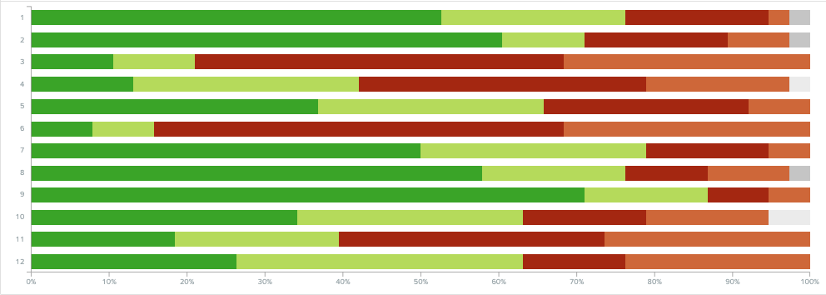
A
We launched our research on IA hypotheses with Veterans
User Story: Iterate on research plan #1 based on VA feedback
User Story: Monitor IA treejack test (#1)
Veteran H0
Research plan #1 approved
Perigean began recruiting
Tests opened to participants
Participant statistics
Veteran H0
- 44 completed
Veteran H1
- 33 completed
Veteran Baseline
- 37 completed
Veteran H1
Caregiver H0
- 4 completed
Caregiver H1
- 2 completed
Caregiver Baseline
- 1 completed
Veteran Baseline
Research plan #1
06-14 Sprint 4 Demo
Health Hub
8

Slide 9
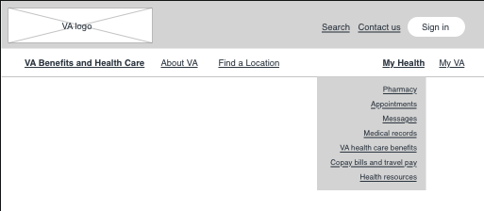
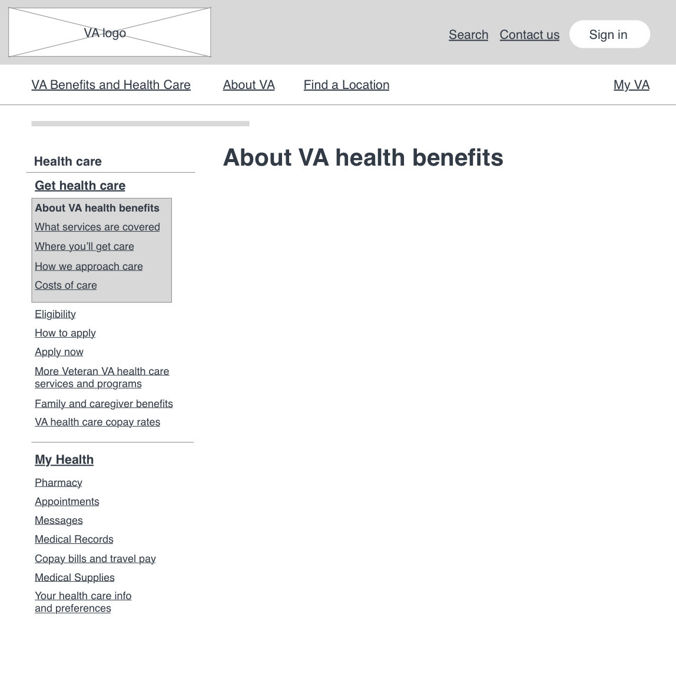
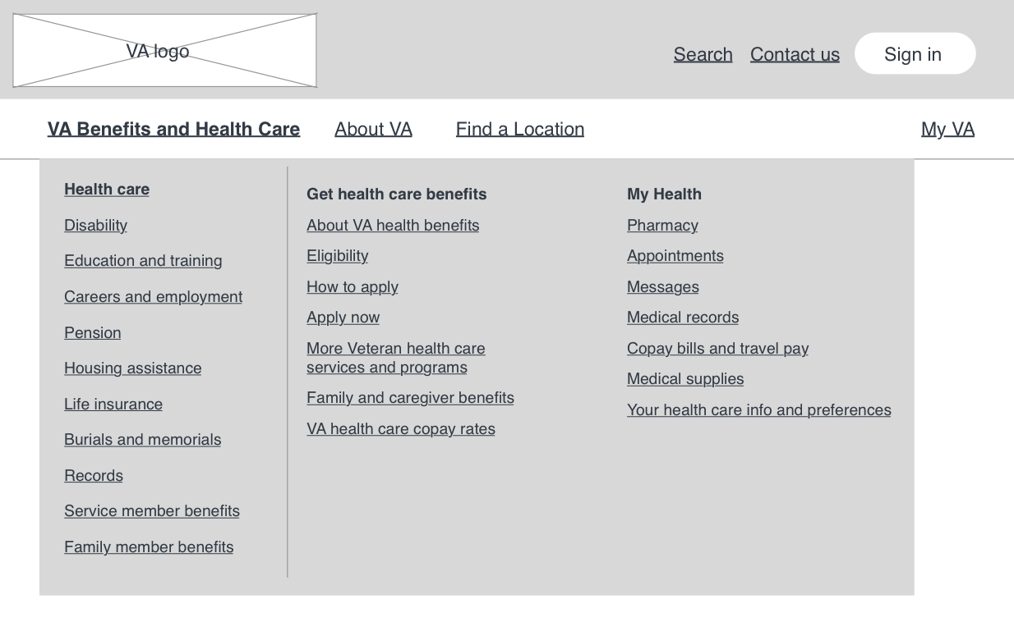
B
We began developing testing protocol for next research phase
User Story: Draft testing protocol for qualitative research on hypotheses
User Story: Begin design for low fidelity prototype IA H1
User Story: Begin design for low fidelity prototype IA H0
Research goal
Use prototypes to test placement of and navigation to ‘My Health’ on VA.gov with Veterans and caregivers.
Research questions
Can Veterans find where to complete ‘manage’ and ‘get’ tasks starting from VA.gov?
Can Veterans navigate to the information or task they need when they land on a page from search (or a link they have)?
Sketch link & working research plan
06-14 Sprint 4 Demo
Health Hub
9

Slide 10
1095-B Status Update
SPRINT 4 DEMO
06-14 Sprint 4 Demo

Slide 11

1095-B Workplan v7
Owned by design team
Owned by product/ engineering team
Release
WE ARE HERE
SPRINT 7
4/20 – 5/03
SPRINT 8
5/04 – 5/17
SPRINT 9
5/18 – 5/31
SPRINT 10
6/01 – 6 /14
SPRINT 11
6/15 – 6/28
SPRINT 13
6/29 – 7/12
SPRINT 14
7/13 – 7/26
SPRINT 15
7/27 – 8/09
SPRINT 16
8/10 – 8/23
SPRINT 17
8/24 – 9/6
1095-B: Spanish translation docs
1095-B: Spanish translation opt-in docs
Turnover document of remaining post-MVP work (VA notify, 2022 IRS form, 508 compliance, multiple year selection)
1095-B: Legal Review
1095-B: Legal Review – Opt-in
Product & Delivery
VA 508 Assistance request
Kickoff
Align on launch MVP v. MVP w/ opt-in
User Experience & Design
Design for opt-in
Launch communication plan
Notification flow
1095-B Wayfinding
Tech feasibility opt-in build
Tech feasibility wayfinding
Engineering & Development
Build for opt-in
Build for wayfinding
Build Analytics for launch monitoring
Collaboration Cycle
Call center review
1095-B Launch
1095-B Post launch evaluation
Sitewide and Content IA ticket
06-14 Sprint 4 Demo
Workplan

Slide 12
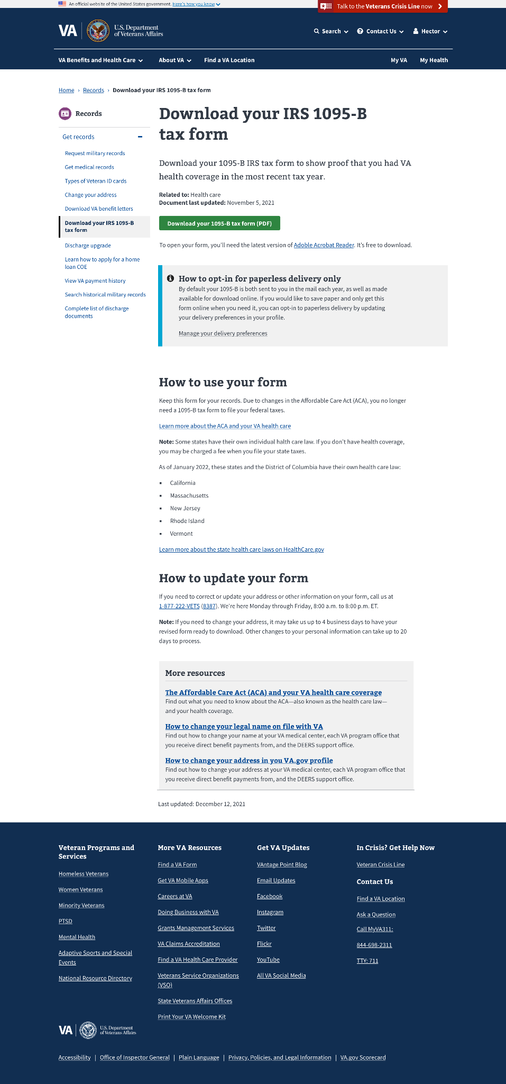
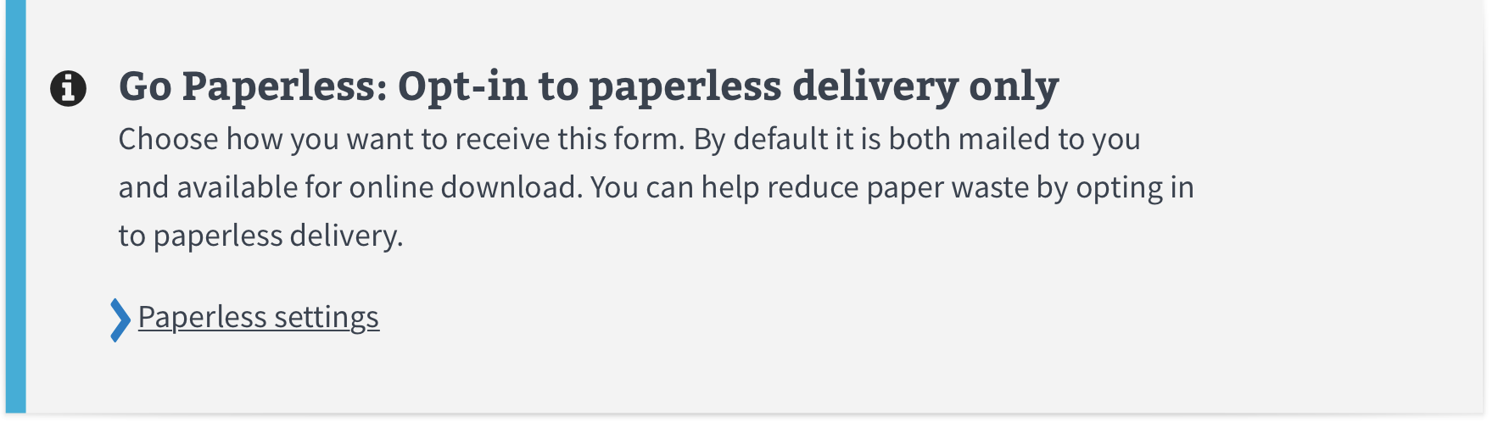
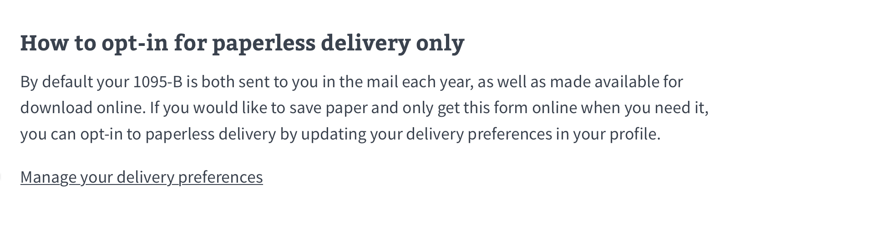
A
Design for opt-in to paperless delivery only of 1095-B
User Story: Align on opt-in scope / plan
User Story: Submit sitewide and content IA ticket for opt-in designs
User Story: Draft opt-in design element prototypes for 1095-B page
User Story: Iterate on call center documents to include drafted opt-in designs and content
User Story: Iterate on HEC documents with draft opt-in content
Option 1
Requirements:
Provide communication and path to user profile allowing users to opt-in for digital form retrieval only
Design Considerations:
Plain language instructions
Clearly define the “what for” of this information
Placed near digital download button to reinforce association with form retrieval function
Component selection that frames and highlights without distracting
Option 2
1095-B Sketch file
06-14 Sprint 4 Demo
1095-B
12

Slide 13
B
We continued to monitor blockers to launching 1095-B
User Story: PM to f/u w/ VA-PO on HEC documents being translated into Spanish
User Story: PM to f/u on VA 508 accessibility support ticket
User Story: Submit and f/u on VA 508 exception request
User Story: Collaboration cycle: Staging review [1095-B]
User Story: User acceptance criteria (UAT) 1095-B
User Story: Collaboration cycle: Analytics implementation [1095-B]
User Story: 1095-B Team staging review accessibility checklist
User Story: PM team to f/u on VA Notify ticket for opt-in
Opt-in:
Need to work out broader flow around email & SMS notifications (like update address)
Lo-Fi flow visuals
Discuss with VA Notify
MVP Blockers:
Accessibility exception request denied by VA 508 office
Spanish translation of MVP HEC documents
1095-B updates 6.14.2022
06-14 Sprint 4 Demo
1095-B
13

Slide 14
Blockers for 1095-B launch
BLOCKER | OWNED BY | ACTION NEEDED | DATE ENTERED | STATUS | NOTES
Legal Review | Tarsha Tremble (Business Owner) | Business Owner is seeking a POC with the Office of General Counsel to understand requirements for legal review and timeline | Sprint 3 - 3/2/22 |  | MVP is approved, opt-in is still under review
PDF Accessibility | Tarsha Tremble (Business Owner) | Team received PDF from IRS, but PDF is still not accessible once it is populated with data | Sprint 3 – 3/3/22 |  | Team is awaiting exception approval from VA 508 office (submitted 6/9)
Spanish Translation | Tarsha Tremble (Business Owner) | Follow up with content finalization and translation progress | Sprint 10 – 6/14/22 |  | June 16 expected date
06-14 Sprint 4 Demo
1095-B Blockers

Slide 15
1095-B Remaining actions, with external dependencies
ITEM | WORK STREAM | ACTION NEEDED | TARGET COMPLETE DATE | PREREQUISITE
Launch | Product & Tech | Work with tech to create a vets-website release | End of June | 508 Exception request
UAT | Product & Tech | Follow Collaboration Cycle guidelines for UAT Identify Veterans within VA to conduct UAT, send access, and follow up to ensure testing complete | TBD | Product dark launched
1095-B Opt-in | Product | Follow up with HEC and Profiles team to ensure 1095-B opt-in is done Follow up with Notifications team to ensure related SMS & e-mail notification flow is optimal Update draft communications and announcement plans, based on when opt-in will be launched | June - July | HEC and Profiles commitment to building opt-in
Legal Review | Product | Work with Tarsha to complete legal review for Opt-In | June – Aug | POC name from Tarsha
Post Launch Check- In | Product | Complete Collaboration Cycle milestone to KPIs post launch | TBD (One month after launch and announcement) | Product launched in prod
Links from VA.gov pages to 1095-B | Product & Design | Work with IA team to have other identified pages within VA.gov (e.g., ACA page) link to the 1095-B page Work with IA team to have 1095-B page added to navigation and be found in VA.gov search | June or later | Product launched in prod; aligned on comm plan with Tarsha, Tracey
1095-B update strategy | Product | Align on who will own 1095-B long term, including updating the PDF template each year | May or later | Product complete and launched in production
Communications to announce launch | Product & Design | Work with Tarsha and HEC team to refine drafted communications and align on plan and timeline to announce 1095-B launch to Veterans Work with VA Notify team to build and launch communications on their platform | October - December 2022 | Product launched in prod; aligned on communication plan with Tarsha/Tracey
06-14 Sprint 4 Demo
1095-B Remaining actions

Slide 16
Sprint Deliverables
SPRINT 4 DEMO
06-14 Sprint 4 Demo

Slide 17
Sprint 4 Deliverables – Health Hub
EPIC | STORY | ESTIMATE | ASSIGNED | OUTPUT | REVIEWED W/ VA-PO | SPRINT TEAM GOAL COMPLETED?
Research | #42129 Iterate on research plan #1 based on VA feedback | 1 | Carolyn Jordan | Research plan#1 | 6/06/22 | ✓
Research | #40689 Monitor IA treejack test (#1) | 3 | Carl Carolyn | Demo deck p. 8 | 6/14/2022 | ✓
Research | #42123 Draft testing protocol for qualitative research on hypothesis | 5 | Thomas | Qualitative protocol - draft Design review #2 deck | 6/09/2022 | ✓
Research | #42072 Begin design for low fidelity prototype IA H1 | 5 | Carolyn | Working sketch | 6/14/2022 | ✓
Research | #42073 Begin design for low fidelity prototype IA H0 | 8 | Carolyn | Working sketch | 6/14/2022 | ✓
Program | #42565 Offboarding of [Jordan S. White] | 3 | Tami Jordan | Ticket | 6/09/2022 | ✓
06-14 Sprint 4 Demo
Sprint 4 Deliverables

Slide 18
Sprint 4 Deliverables – 1095-B
EPIC | STORY | ESTIMATE | ASSIGNED | OUTPUT | REVIEWED W/ VA-PO | SPRINT TEAM GOAL COMPLETED?
Product | #40454 PM to f/u w/ VA-PO on HEC documents being translated into Spanish | 0 | Tami | 1095-B updates | 6/14/2022 | ✓
Product | #39722 PM to f/u on VA 508 accessibility support ticket | 1 | Tami | YourIT # RITM6608047 1095-B updates | 6/09/2022 | ✓
Product | #42660 Submit and f/u on VA 508 exception request | 2 | Tami | YourIT #REQ7026762 1095-B updates | 6/9/2022 | ✓
Product | #38351 Collaboration cycle: Staging review [1095-B] | 0 | Jordan | Ticket | 6/14/2022 | ✓
Tech | #41560 User acceptance criteria (UAT) 1095-B | 0 | Teagan Shashank | NR | 6/14/2022 | ✓
Tech | #36175 Collaboration cycle: Analytics implementation [1095-B] | 0 | Teagan Shashank | Ticket | 6/14/2022 | ✓
Tech | #38387 1095-B Team staging review accessibility checklist | 0 | Teagan Shashank | Ticket | 6/14/2022 | ✓
Product | #39723 PM team to f/u on VA Notify ticket for opt-in | 1 | Tami | #CMDMRP-2269 1095-B updates | 6/14/2022 | ✓
Product | #42125 Align on opt-in scope / plan | 1 | Jordan | NR | 6/6/2022 | ✓
Product | #42163 Submit sitewide and content IA ticket for opt-in designs | 2 | Tami | Z#42694 | 6/10/2022 | ✓
Design | #42102 Draft opt-in design element prototypes for 1095-B page | 5 | Thomas | 1095-B Design Sketch file(w Opt-in) Design review #2 deck | 6/09/2022 | ✓
Content | #42156 Iterate on call center documents to include drafted opt-in designs and content | 5 | Carl | Product guide Paperless delivery notification | 6/14/2022 | ✓
Content | #42155 Iterate on HEC documents with draft opt-in content | 2 | Carl | FAQ’s Fact sheet User guide Cover letter | 6/14/2022 | ✓
06-14 Sprint 4 Demo
Sprint 4 Deliverables

Slide 19
Preview of Sprint 5
SPRINT 4 DEMO
06-14 Sprint 4 Demo

Slide 20
Sprint 5 of Health Hub will focus on
 | Next sprint demo: June 28th
HEALTH HUB
*Stories subject to change during Sprint planning
IA Tree Test Monitoring
IA Tree Test Synthesis
1095-B
1095-B Blockers
Opt-in component
Low fidelity options – visuals
Discuss with VA Notify team
Process map
06-14 Sprint 4 Demo
Preview of Sprint 5 – Health Hub

Slide 21
Appendix
SPRINT 4 DEMO
06-14 Sprint 4 Demo

Slide 22
Project risks and mitigation strategies (1 of 2)
RISK AND IMPACT | MITIGATION STRATEGY | DATE |  | STATUS | NOTES
 |  | ENTERED | CLOSED
IRS stakeholder is outside of VA ecosystem. Building without guidance or legal review regarding compliance with IRS regulation could result in risk. | Conduct research on available information surrounding current IRS 1095-B tax form regulations. Seek legal review through VA resources as directed by VA-PO and Business Owner | 1/20/22 | 2/11/22 |  | VA Business Owner clarified that IRS review is not needed
Team had previously confirmed with Business Owner that legal review was not needed. Business Owner clarified that legal review would be needed as of March 2nd | Business Owner is seeking a POC with the Office of General Counsel to understand what is needed and potential launch impact | 3/2/22 | 5/17/22 |  | Launch blocker
Data requires storage in a S3 bucket that the enrollment system can have access to in production; process to create the staging and production bucket does not have a clear timeline. Without the S3 bucket in prod with enrollment system access, product cannot be built in prod | Daily follow-ups with Jesse House and Mike Chelan (infrastructure team) | 3/1/22 | 3/24/22 |  | S3 bucket now in place. Risk resolved.
Business owner raised User Acceptance Testing should be done with HEC Call Center | Requested Business Owner to schedule UAT with required individuals for mid-March and book as early as possible | 3/2/22 | 3/25/22 |  | Business owner confirmed that UAT can be done through Collaboration Cycle and does not have to be done with HEC team
Feedback from Content and IA Review has taken over a week to come in; feedback is changing our proposal for the H1 and delaying confirmation of where the 1095-B landing page should live, which in turn delays our ability to complete the front end (top nav and side nav bars) | Design team pushing on IA team to confirm final answer of where 1095-B landing page should live and what the H1 header title should be | 03/04/22 | 3/8/22 |  | URL confirmed 3/7 EOD; IA review now closed
Designs were approved as part of Midpoint Review. Afterwards, Sitewide Content stated they would need to build our front end in Drupal and change our designs, impacting our in-flight build. | Design team met with Sitewide Content to align on redesigned front end. Tech working with Sitewide Content to send over our dynamic widget to be pulled into their static front end. Sitewide Content now owns the front end build. | 3/10/22 |  |  | Launch date dependent on Sitewide Content ability to launch front end

Slide 23
Project risks and mitigation strategies (2 of 2)
RISK AND IMPACT | MITIGATION STRATEGY | DATE |  | STATUS | NOTES
 |  | ENTERED | CLOSED
HH Tree Test design held up due to new information from Meg, Danielle and Mikki. | VA and MO team could work in collaborative sessions so that work is not duplicated, and we can arrive at a test design that works by the end of Sprint 3 | 5/16/22 | 5/26/22 |  | Awaiting version of ‘manage’ tree that we can incorporate into research trees in order to move forward with research plan
HEC Legal review required for 1095-B Opt-in | Opt-in is being built by VA Profile team | 3/2/22 | 5/17/22 |  | Post-MVP enhancement blocker
06-14 Sprint 4 Demo

Slide 24
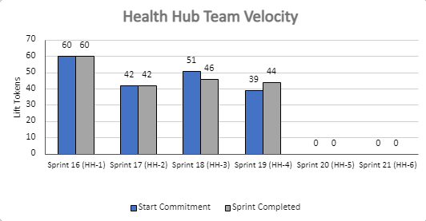
Health Hub Team velocity
 | Velocity details Velocity estimated in story points, using Fibonacci Velocity in Sprint 4 accounted for 6 team members 44 total story points were completed; Team committed to 39 story points at beginning of the sprint. 2 Stories added (5) off boarding Jordan and submitting sitewide / Content IA ticket 4 stories blocked (0) pending IRS accessibility solution
06-14 Sprint 4 Demo
Appendix
24

Slide 26
D
Lorem
User Story: Lorem
User Story: Lorem
User Story: Lorem
User Story: Lorem
User Story: Lorem
Lorem
Lorem
Lorem
Lorem
Lorem
Lorem
Lorem
Link
06-14 Sprint 4 Demo
Health Hub
26

Slide 27
C
Lorem
User Story: Lorem
User Story: Lorem
User Story: Lorem
User Story: Lorem
User Story: Lorem
Lorem
Lorem
Lorem
Lorem
Lorem
Lorem
Lorem
Link
06-14 Sprint 4 Demo
Health Hub
27

Slide 28
A
Lorem
User Story: Lorem
User Story: Lorem
User Story: Lorem
User Story: Lorem
User Story: Lorem
Lorem
Lorem
Lorem
Lorem
Lorem
Lorem
Lorem
Link
06-14 Sprint 4 Demo
Lorem
28

Slide 29
C
m
User Story: Lorem
User Story: Lorem
User Story: Lorem
User Story: Lorem
User Story: Lorem
Lorem
Lorem
Lorem
Lorem
Lorem
Lorem
Lorem
Link
06-14 Sprint 4 Demo
1095-B
29

Slide 30
2
DESIGN
Lorem
User Story: Lorem
User Story: Lorem
Lorem
Lorem
Link
05-03 Sprint 1 Demo
Design
30

Slide 31
A
Lorem
User Story: Lorem
User Story: Lorem
Lorem
Lorem
Link
05-31 Sprint 3 Demo
Health Hub
31

Slide 32
2
DESIGN
Lorem
User Story: Lorem
User Story: Lorem
Lorem
Lorem
Link
05-03 Sprint 1 Demo
Design
32

Slide 33
3
PRODUCT
Lorem
User Story: Lorem
User Story: Lorem
Lorem
Lorem
Link
05-03 Sprint 1 Demo
Product
33

Slide 34
1
TECH
Lorem
User Story: Lorem
User Story: Lorem
User Story: Lorem
User Story: Lorem
User Story: Lorem
Lorem
Lorem
Lorem
Lorem
Lorem
Lorem
Lorem
Link
05-03 Sprint 1 Demo
Tech
34

Slide 35
2
DESIGN
Lorem
User Story: Lorem
User Story: Lorem
Lorem
Lorem
Link
05-03 Sprint 1 Demo
Design
35

Slide 36
2
DESIGN
Lorem
User Story: Lorem
User Story: Lorem
Lorem
Lorem
Link
05-03 Sprint 1 Demo
Design
36

Slide 37
3
PRODUCT
Lorem
User Story: Lorem
User Story: Lorem
Lorem
Lorem
Link
05-03 Sprint 1 Demo
Product
37

Slide 38
D
Lorem
User Story: Lorem
User Story: Lorem
User Story: Lorem
User Story: Lorem
User Story: Lorem
Lorem
Lorem
Lorem
Lorem
Lorem
Lorem
Lorem
Link
06-14 Sprint 4 Demo
1095-B
38

Slide 39
Sprint 1 will run April 20 to May 3rd
Owned by design team
Owned by product/ engineering team
Release
WE ARE HERE
SPRINT 1
SPRINT 2
SPRINT 3
SPRINT 4
SPRINT 5
Week 1: 04/20 – 04/26
Week 2: 04/27 – 05/03
Week 3: 05/04 – 05/10
Week 4: 05/11- 05/17
Week 5: 05/18 – 05/24
Week 6: 05/25 – 05/31
Week 7: 06/01 – 06/07
Week 8:
06/08 – 06/14
Week 9: 06/15-06/21
Week 10: 06/22-06/28
Product & Delivery
1095-B: Identify Change Management or Communications Plan
1095-B: Legal Review
1095-B: Handover plan - Prepare for launch
1095-B: Opt-in follow up
1095-B: Spanish translation docs
HH: Charter
HH: Develop backlog + Vision Framework
HH: Roadmap
User Experience & Design
1095-B: Wayfinding plan
Testing prep & recruiting
Voice of Veteran
Voice of Veteran
HH: Discovery
HH: Stakeholder Interviews
HH: Current State Journey Map
Prioritized plan
Engineering & Development
HH: Tech discovery
HH: Stakeholder Interviews
HH: Proposed tech integrations based off research findings
Collaboration Cycle
Midpoint Review
1095-B: Launch Date Dependent on Legal Review Completion
Research Plan Review
Research Plan Review
*Does not show post-MVP Validate phase meetings in Collaboration Cycle, such as Full Accessibility Audit and Post-Launch Check In; Contact Center Review adjusted to 3 weeks before launch as approved by Jason Woodman
Preview of Sprint 7

